Slide 1


Chương 8 - Activity Diagram

Slide 2
Content
Introduction
Activities
Actions
Edges
Control flow
Object flow
Initial node, activity final node, flow final node
Alternative paths
Concurrent paths
Object nodes
Event-based actions and call behavior actions
Partitions
Exception handling

Slide 3
Introduction
Focus of activity diagram: procedural processing aspects
Flow-oriented language concepts (các khái niệm về ngôn ngữ hướng luồng)
Based on
languages for defining business processes (ngôn ngữ để định nghĩa tiến trình kinh doanh)
established concepts for describing concurrent communicating processes (các khái niệm để mô tả tiến trình giao tiếp đồng thời)
Concepts and notation variants cover broad area of applications (khái niệm và ký hiệu bao gồm nhiều lĩnh vực ứng dụng khác nhau)
Modeling of object-oriented and non-object-oriented systems

Slide 4
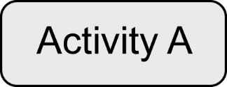
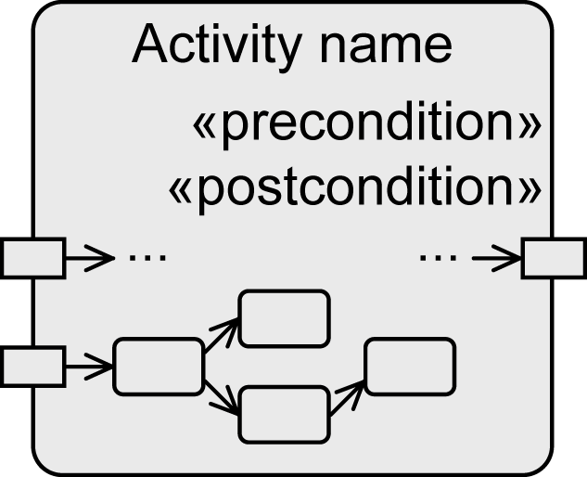
Activity
Specification of user-defined behavior at different levels of granularity
Examples:
Definition of the behavior of an operation in the form of individual instructions
Modeling the course of actions of a use case
Modeling the functions of a business process
An activity is a directed graph
Nodes: actions and activities
Edges: for control and object flow
Control flow and object flow define
the execution
Optional:
Parameter
Pre- and postconditions
Output
parameter
Input
parameter
Node
Edge
Notes:
Sự mô tả hành vi do người dùng định nghĩa ở các mức độ chi tiết khác nhau

Slide 5
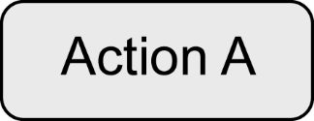
Action
Basic element to specify user-defined behavior
Atomic but can be aborted
No specific rules for the description of an action
→Definition in natural language or in any programming language
Process input values to produce output values
Special notation for predefined types of actions, most importantly
Event-based actions
Call behavior actions

Slide 6

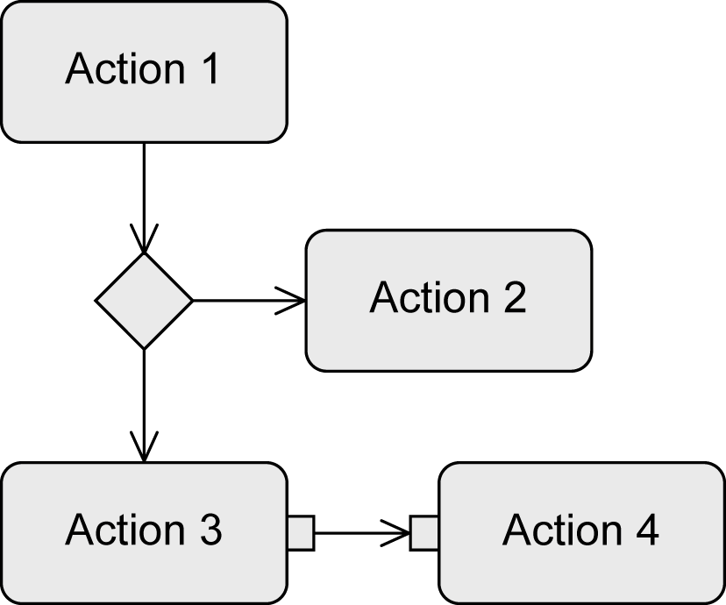

Edges
Connect activities and actions to one another
Express the execution order
Types
Control flow edges
Define the order between nodes
Object flow edges
Used to exchange data or objects
Express a data/causal dependency between nodes
Guard (condition)
Control and object flow only continue if guards in square brackets evaluate to true
Control flow
Object flow

Slide 7
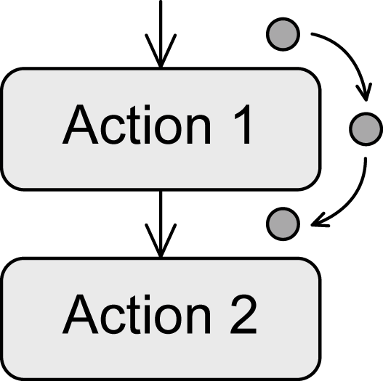
Token
Virtual coordination mechanism that describes the execution exactly
No physical component of the diagram
Mechanism that grants the execution permission to actions
If an action receives a token, the action can be executed
When the action has completed, it passes the token to a subsequent action and the execution of this action is triggered
Guards can prevent the passing of a token
Tokens are stored in previous node
Control token and object token
Control token: “execution permission" for a node
Object token: transport data + “execution permission”

Slide 8



Beginning and Termination of Activities
Initial node
Starts the execution of an activity
Provides tokens at all outgoing edges
Keeps tokens until the successive nodes accept them
Multiple initial nodes to model concurrency
Activity final node
Ends all flows of an activity
First token that reaches the activity final node terminates the entire activity
Concurrent subpaths included
Other control and object tokens are deleted
Exception: object tokens that are already present at the output parameters of the activity
Flow final node
Ends one execution path of an activity
All other tokens of the activity remain unaffected

Slide 9

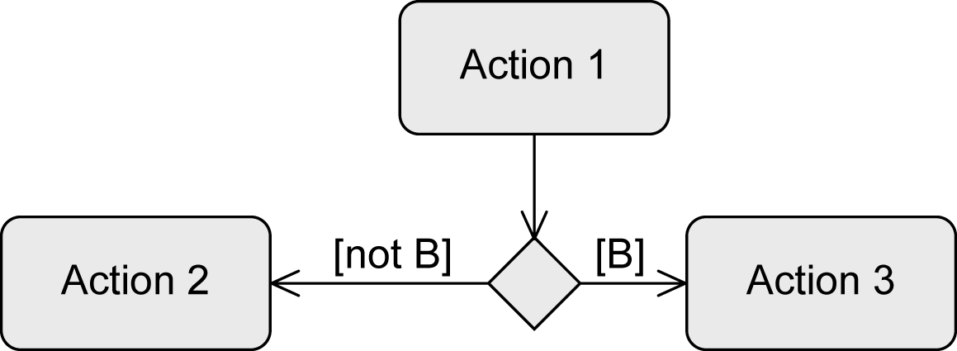
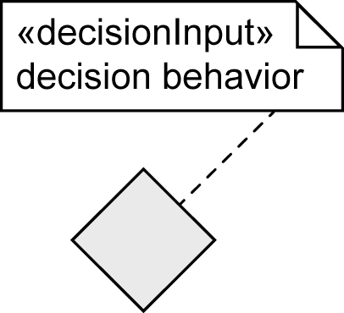
Alternative Paths – Decision Node
To define alternative branches
„Switch point“ for tokens
Outgoing edges have guards
Syntax: [Boolean expression]
Token takes one branch
Guards must be mutually exclusive
Predefined: [else]
Decision behavior
Specify behavior that is necessary for the evaluation of the guards
Execution must not have side effects

Slide 10

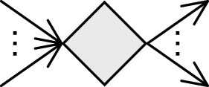
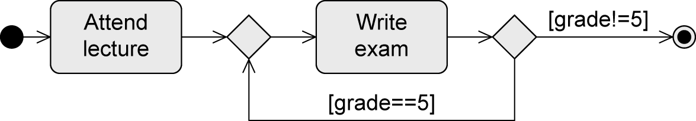
Alternative Paths – Merge Node
To bring alternative subpaths together
Passes token to the next node
Combined decision and merge node
Decision and merge nodes can also be used to model loops:

Slide 11
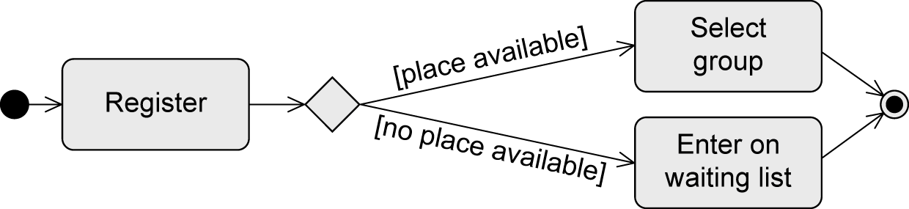
Example: Alternative Paths

Slide 12
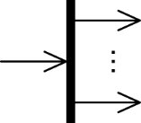
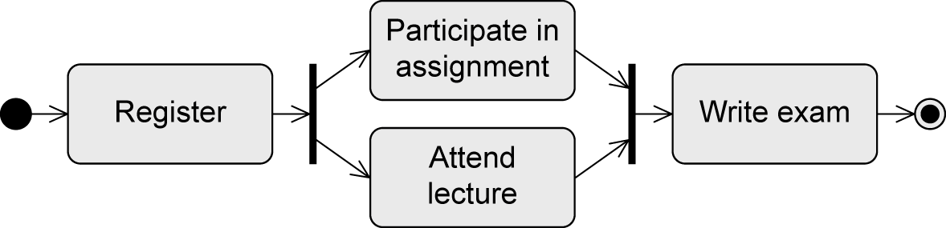
Concurrent Paths – Parallelization Node
To split path into concurrent subpaths
Duplicates token for all outgoing edges
Example:

Slide 13
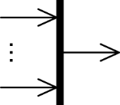
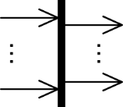
Concurrent Paths – Synchronization Node
To merge concurrent subpaths
Token processing
Waits until tokens are present at all incoming edges
Merges all control tokens into one token and passes it on
Passes on all object tokens
Combined parallelization and synchronization node:

Slide 14
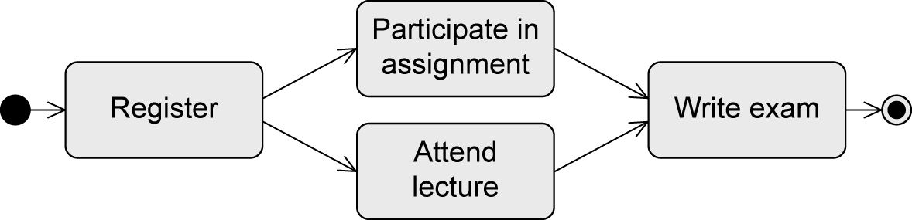
Example: Equivalent Control Flow
… equivalent to …

Slide 15
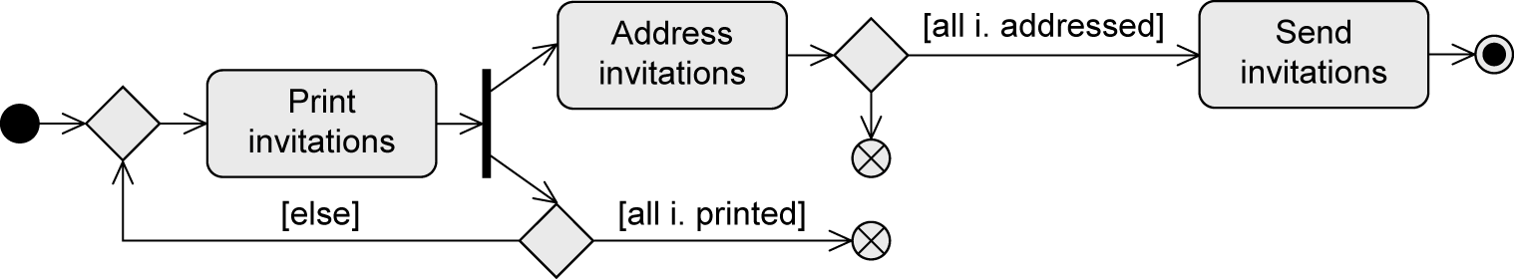
Example: Create and Send Invitations to a Meeting
While invitations are printed, already printed invitations are addressed.
When all invitations are addressed, then the invitations are sent.

Slide 16
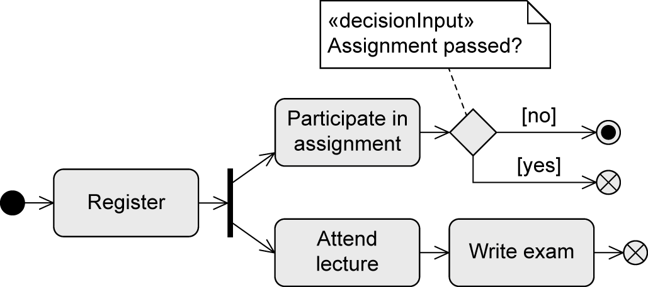
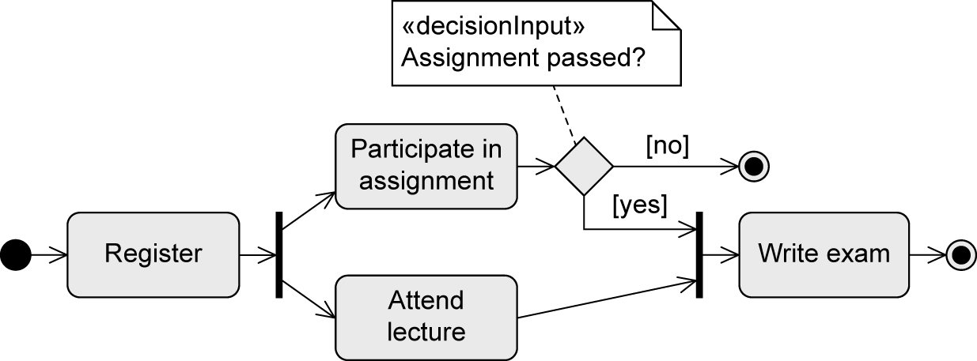
Example: Conduct Lecture (Student Perspective)
NOT equivalent … why?

Slide 17
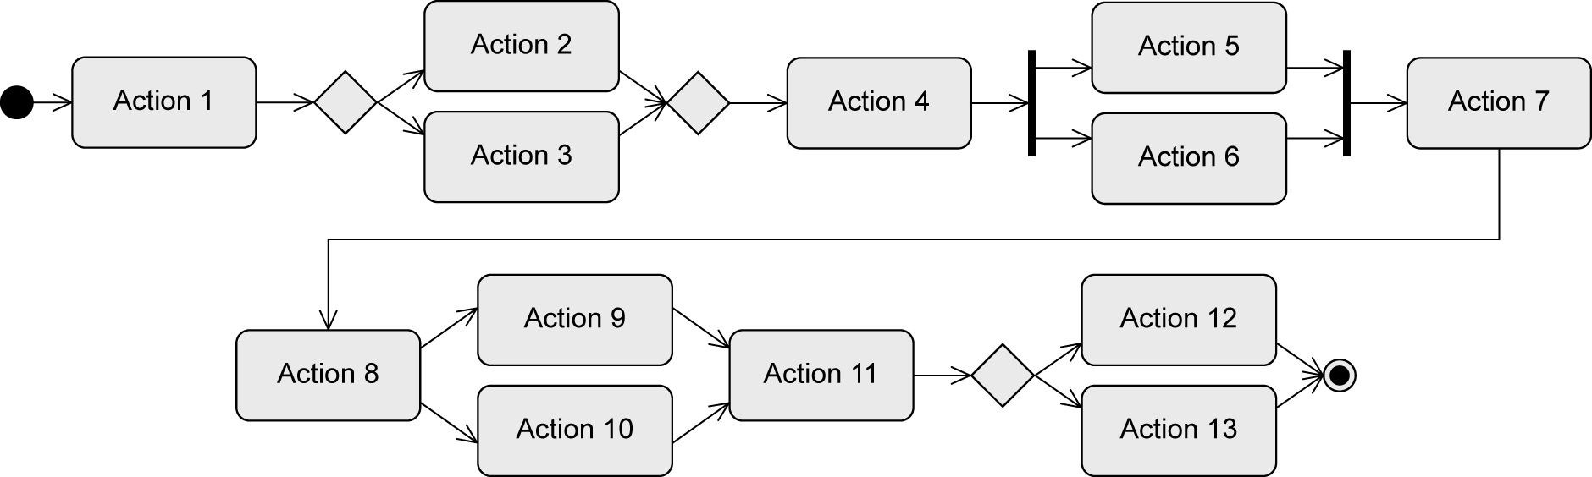
Example: Token (Control Flow)
x
x
x
x
x
x
x
x
x
x
x
x
x
x
x
x
End !
x
x
x
… all outgoing edges of all initial nodes are assigned a token….
… if all incoming edges of an action have a token, the action is activated and is ready for execution
… before the execution, the action consumes one token from every incoming edge; after the execution, the action passes one token to every outgoing edge
… a decision node passes the token to one outgoing edge (depending on the result of the
evaluation of the guard)
… a merge node individually passes each token it gets to its outgoing edge
… a parallelization node duplicates an incoming token for all outgoing edges
… a synchronization node waits until all incoming edges have a token, merges them to a single token and passes it to its outgoing edge
… the first token that reaches the activity final node terminates the entire activity

Slide 18
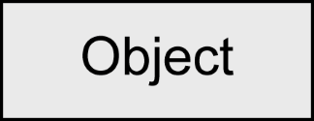
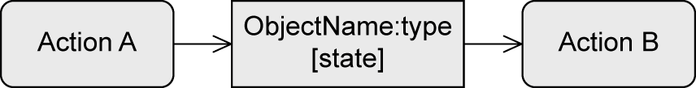
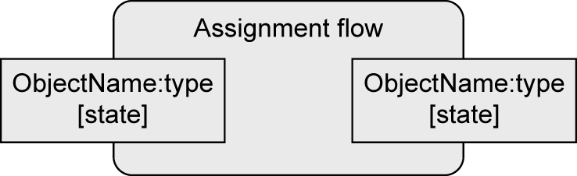
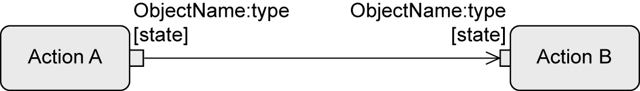
Object Node
Contains object tokens
Represents the exchange of data/objects
Is the source and target of an object flow edge
Optional information: type, state
Notation variant: object node as parameter
For activities
For actions (“pins”)
Input
parameter
Output
parameter

Slide 19
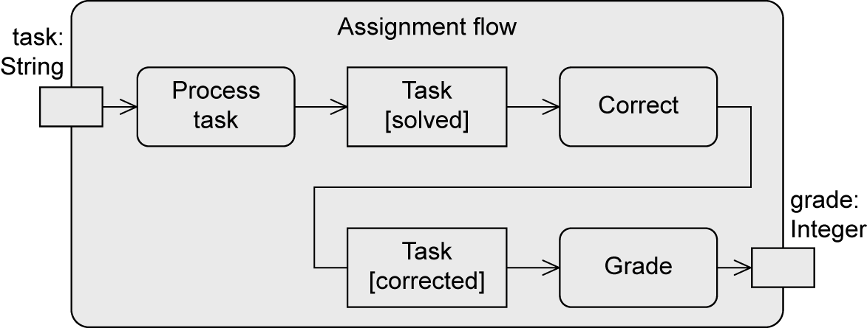
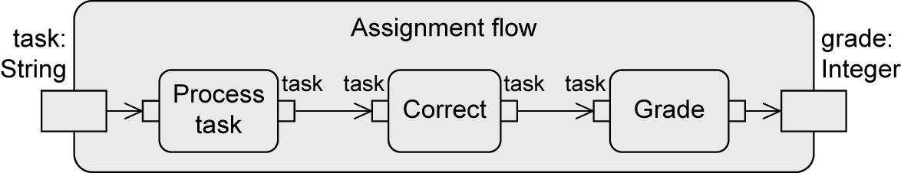
Example: Object Node

Slide 20
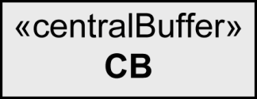
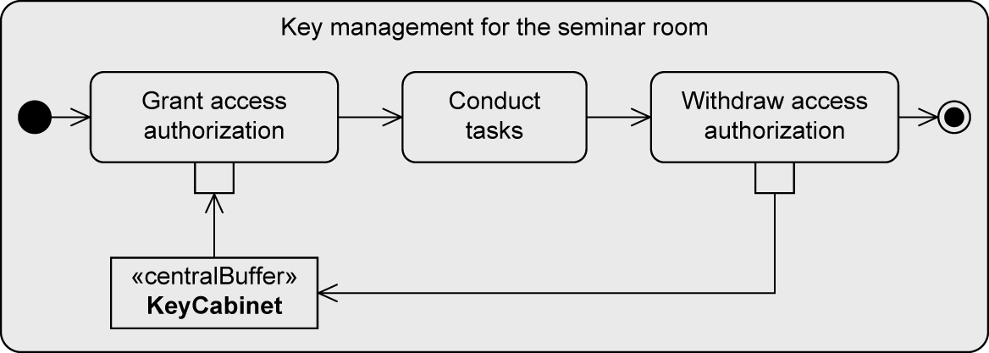
Central Buffer
For saving and passing on object tokens
Transient memory
Accepts incoming object tokens from object nodes and passes them on to other object nodes
When an object token is read from the central buffer, it is deleted from the central buffer and cannot be consumed again

Slide 21
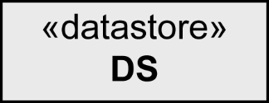
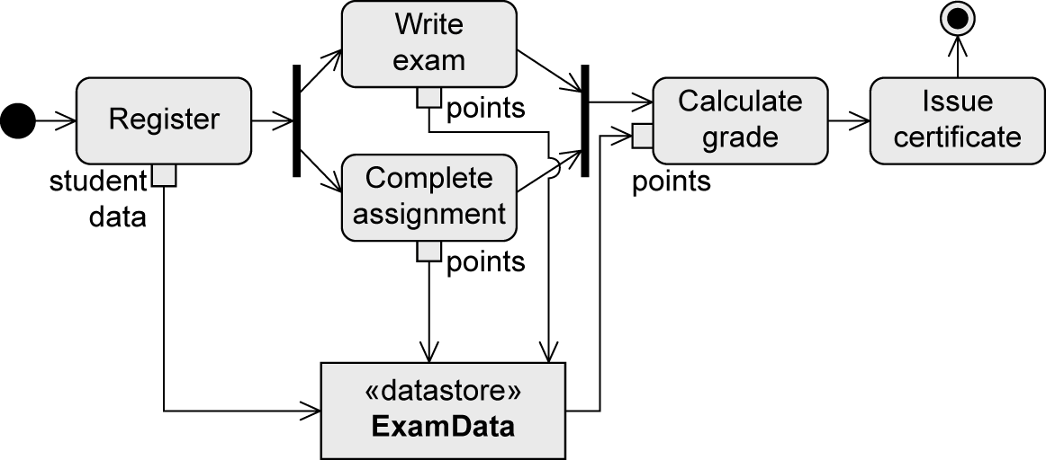
Data Store
For saving and passing on object tokens
Permanent memory
Saves object tokens permanently, passes copies to other nodes

Slide 22

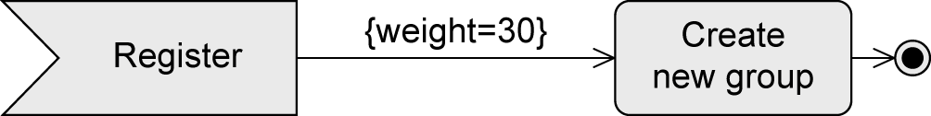
Weight of Edges
Minimal number of tokens that must be present for an action to be executed
Default: 1
All tokens present have to be consumed: 0 (also all or *)

Slide 23

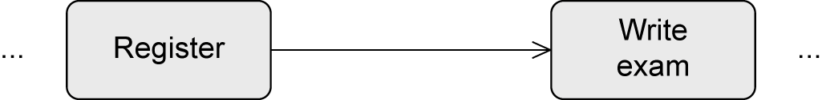
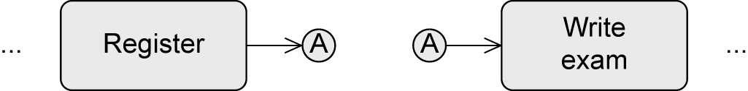
Connector
Used if two consecutive actions are far apart in the diagram
Without connector:
With connector

Slide 24
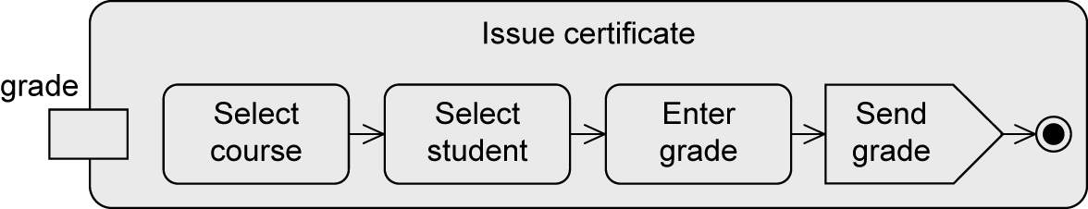
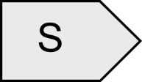

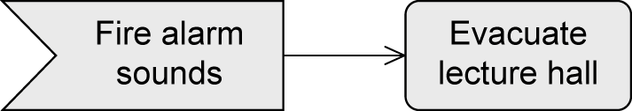
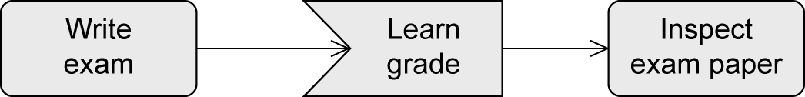

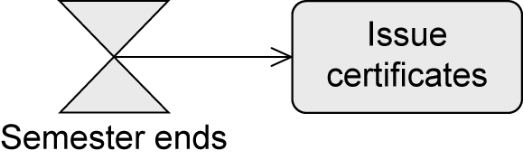
Event-Based Actions
To send signals
Send signal action
To accept events
Accept event action
Accept time event action

Slide 25
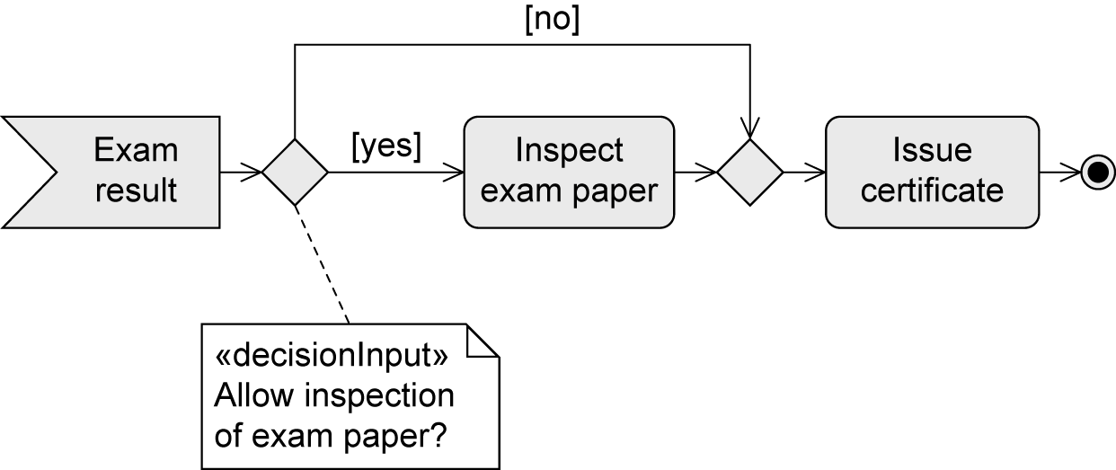
Example: Accept Event Action

Slide 26
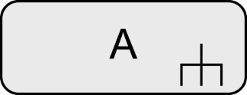
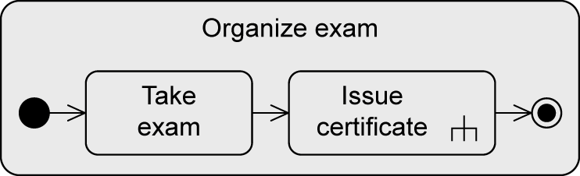
Call Behavior Action
The execution of an action can call an activity
Content of the called activity can be modeled elsewhere
Advantages:
Model becomes clearer
Reusability
Name of the called activity
Inverted fork symbol

Slide 27
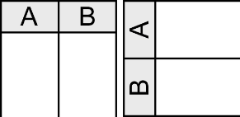
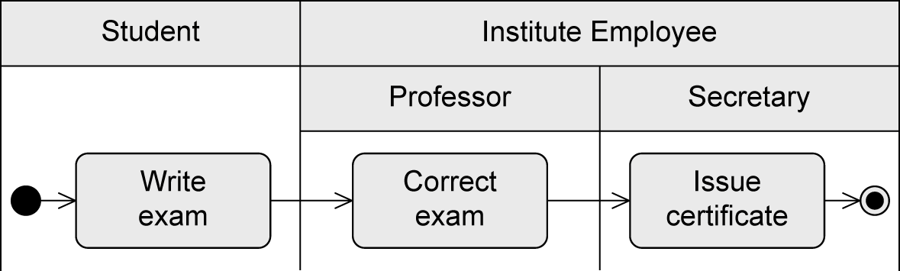
Partition
“Swimlane”
Graphically or textual
Allows the grouping of nodes and edges of an activity due to responsibilities
Responsibilities reflect organizational units or roles
Makes the diagram more structured
Does not change the execution semantics
Example: partitions Student and Institute Employee (with subpartitions Professor and Secretary)

Slide 28
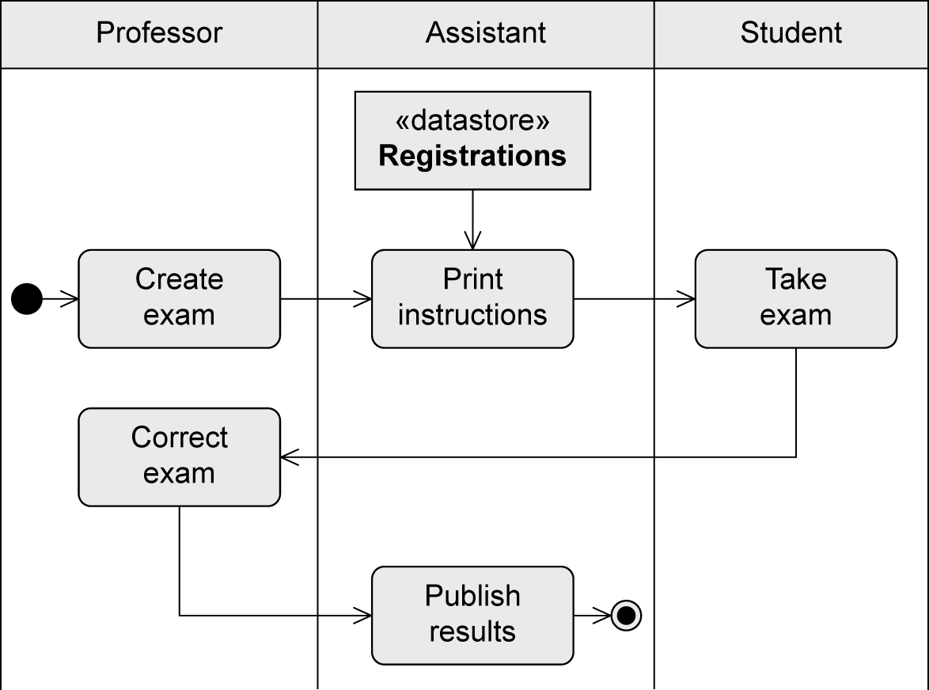
Example: Partitions

Slide 29
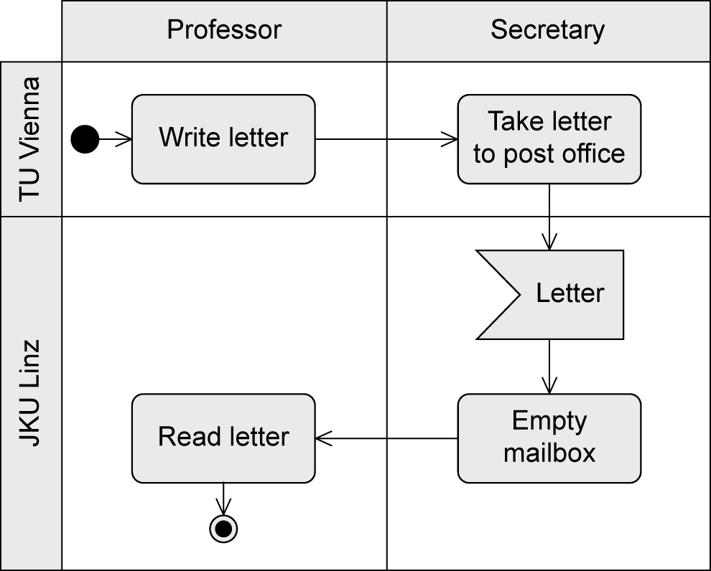
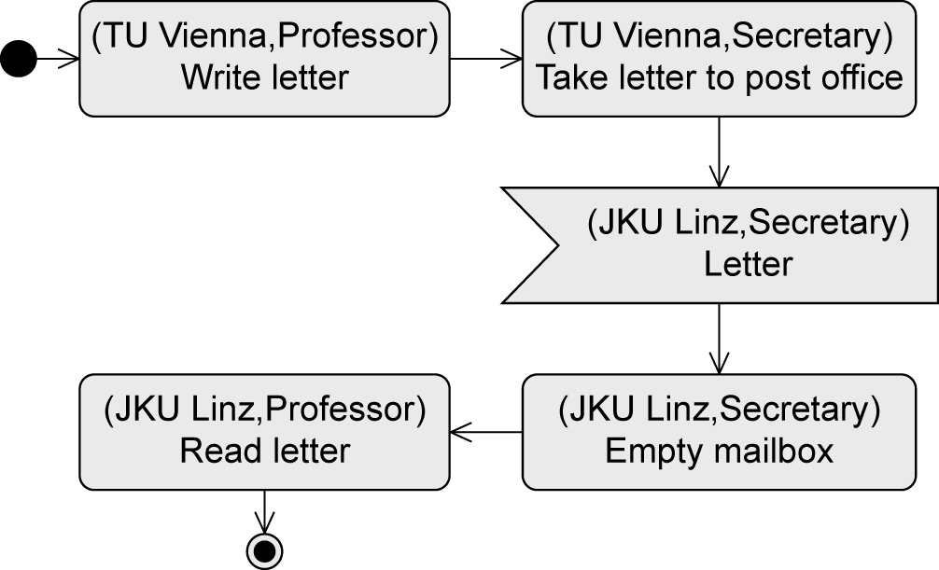
Multidimensional Partitions
Graphical notation … or alternatively textual notation

Slide 30
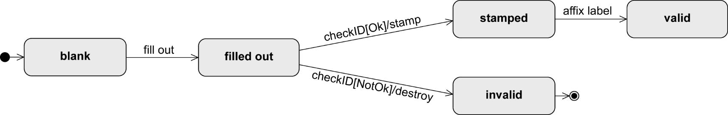
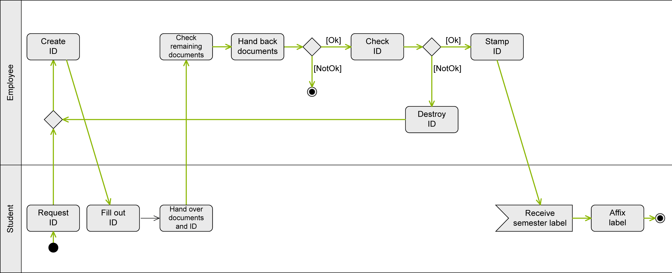
Example: Issue Student ID on Paper (1/2)
State machine diagram of Student ID:
Activity diagram – control flow:

Slide 31
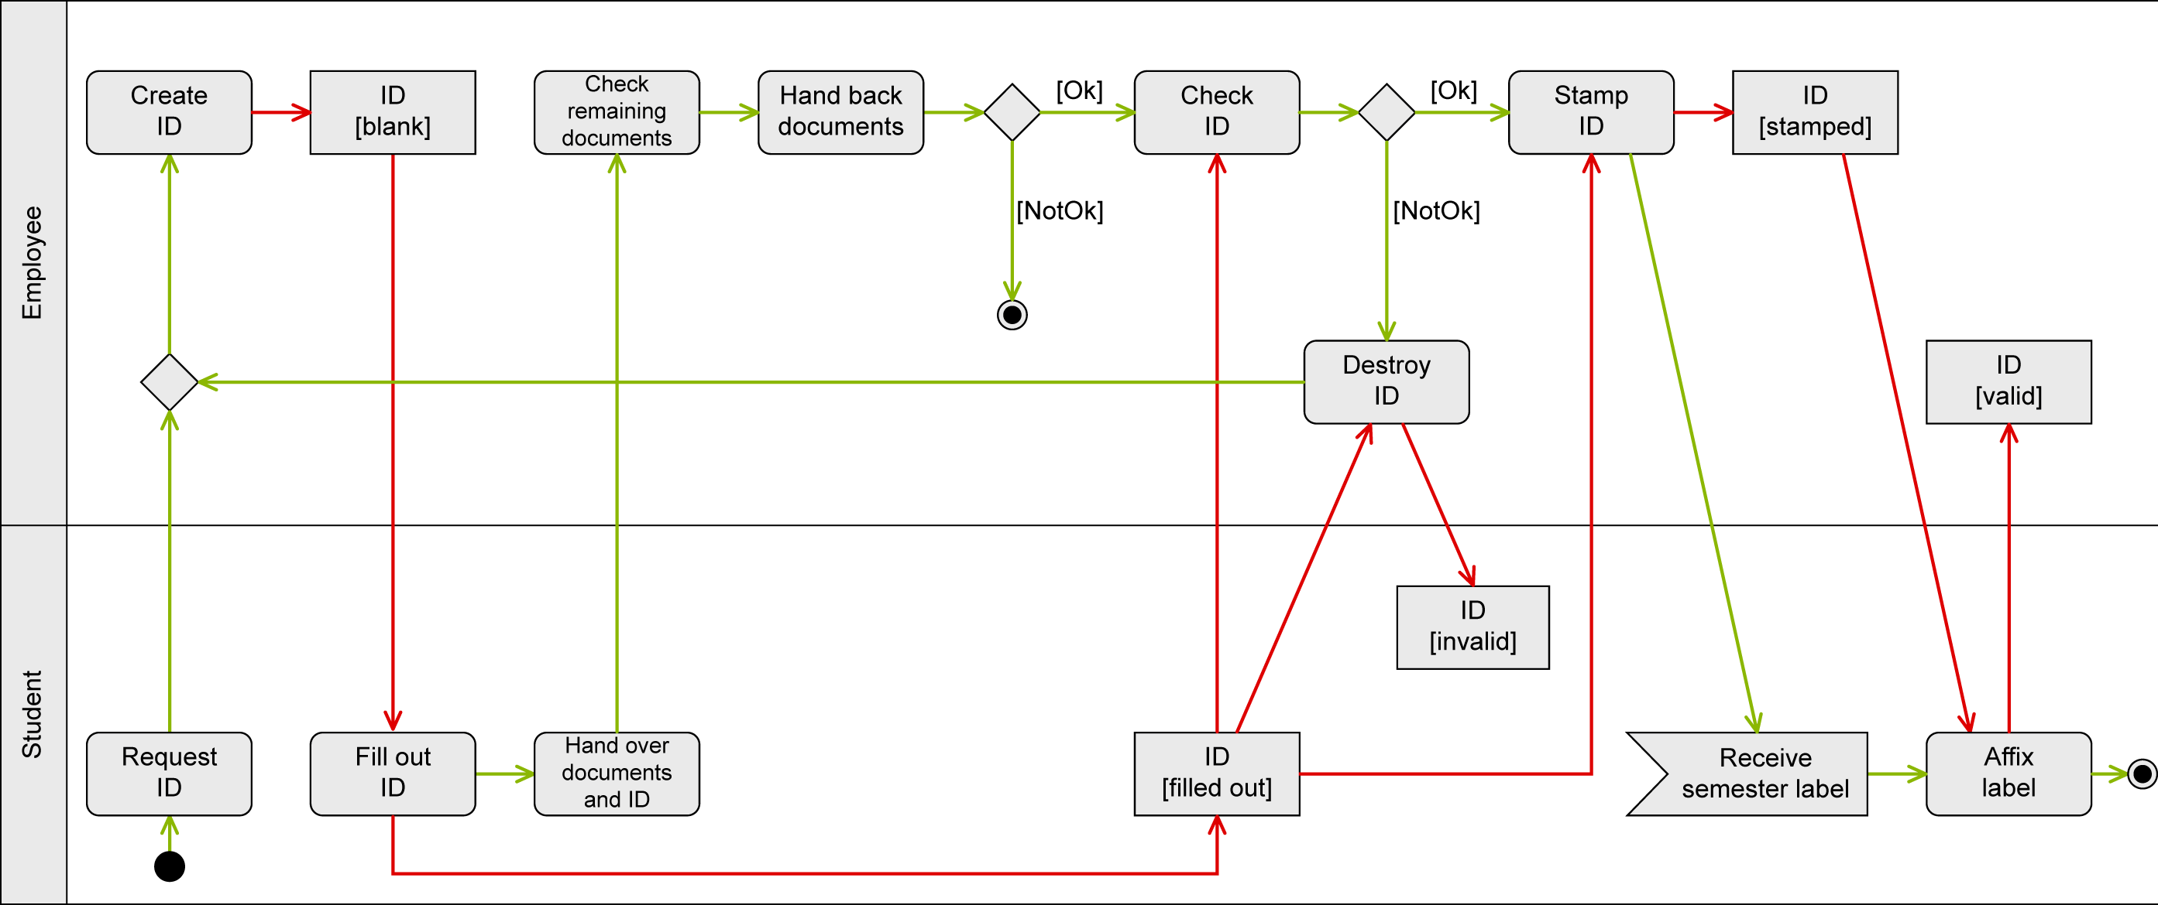
Example: Issue Student ID on Paper (2/2)
Control flow (green) and object flow (red) in one activity diagram

Slide 32
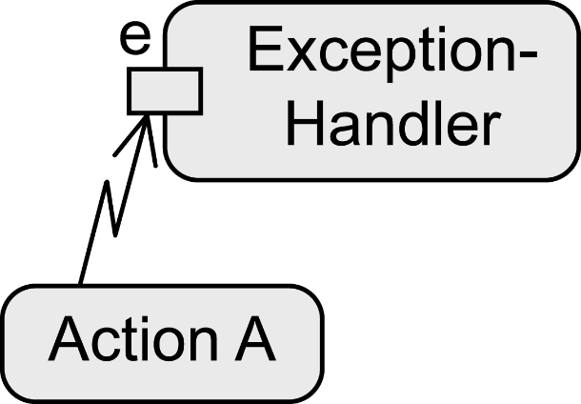
Exception Handling – Exception Handler
Predefined exceptions
Defining how the system has to react in a specific error situation
The exception handler replaces the action where the error occurred
If the error e occurs…
All tokens in Action A are deleted
The exception handler is activated
The exception handler is executed instead of Action A
Execution then continues regularly

Slide 33
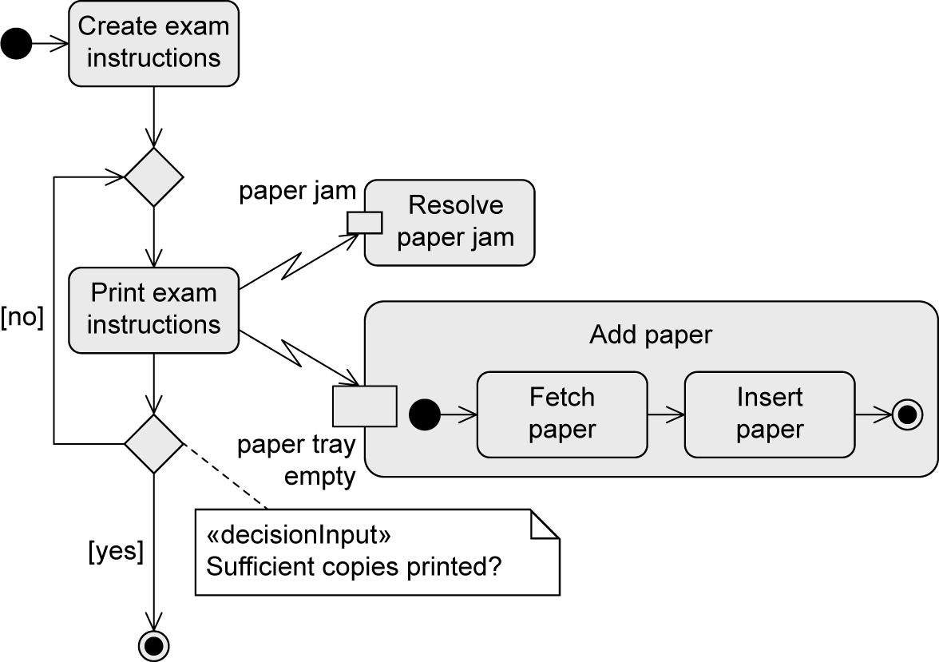
Example: Exception Handler

Slide 34

Exception Handling– Interruptible Activity Region
Defining a group of actions whose execution is to be terminated immediately if a specific event occurs. In that case, some other behavior is executed
If E occurs while B or C are executed
Exception handling is activated
All control tokens within the dashed rectangle (= within B and C) are deleted
D is activated and executed
No “jumping back” to the regular execution!

Slide 35

Example: Interruptible Activity Region

Slide 36


Notation Elements (1/5)
Name | Notation | Description
Action node Activity node |  | Represents an action (atomic!) Represents an activity (can be broken down further)
Initial node |  | Start of the execution of an activity
Activity final node |  | End of ALL execution paths of an activity

Slide 37

Notation Elements (2/5)
Name | Notation | Description
Decision node Merge node |  | Splitting of one execution path into alternative execution paths Merging of alternative execution paths into one execution path
Parallelization node Synchronization node |  | Splitting of one execution path into concurrent execution paths Merging of concurrent execution paths into one execution path

Slide 38

Notation Elements (3/5)
Name | Notation | Description
Flow final node |  | End of ONE execution path of an activity
Edge |  | Connection between the nodes of an activity
Call behavior action |  | Action A refers to an activity of the same name
Partition |  | Grouping of nodes and edges within an activity

Slide 39



Notation Elements (4/5)
Name | Notation | Description
Send signal action |  | Transmission of a signal to a receiver
Asynchronous accept (timing) event action |  | Wait for an event E or a time event T
Object node |  | Contains data or objects
Parameter for activities Parameter for actions (pins) |  | Contains data and objects as input and output parameters

Slide 40


Notation Elements (5/5)
Name | Notation | Description
Exception Handler |  | Exception handler is executed instead of the action in the event of an error e
Interruptible activity region |  | Flow continues on a different path if event E is detected

Slide 41

Câu hỏi ?
Notes:
Nguồn: www.clipartkid.com

